Slide 1
Heritage High School Sophomore and Junior Night
The Class of 2015 and 2016
October 1, 2013

Slide 2
Areas of Focus
Post Secondary Planning
Academics
Getting Involved/Leadership
Please visit our departmental website by linking off of the new HHS website: http://www.heritagehs.wcpss.net/ - this opens best in Firefox or Google Chrome
Notes:
RC

Slide 3
Post-Secondary Planning
Career Exploration
Military Options
College Research
It is a great time for exploring all of your interests and doing research on where you want to go after high school.
Notes:
RC

Slide 4
Career Exploration
Resources – School Counselor, Career Development Coordinator, Online Sites
www.f4k.org- Futures for Kids
www.cfnc.org
PLAN (Practice ACT) – includes a career interest inventory, this Thursday, Oct 3rd, scores will return in December or January
Job Shadowing – Ms. Wiggins, CDC
Internships
CTE High School and Career and College Promise
Selective Scheduling – register for classes that are related to the fields that you have interest in
Notes:
RC

Slide 5
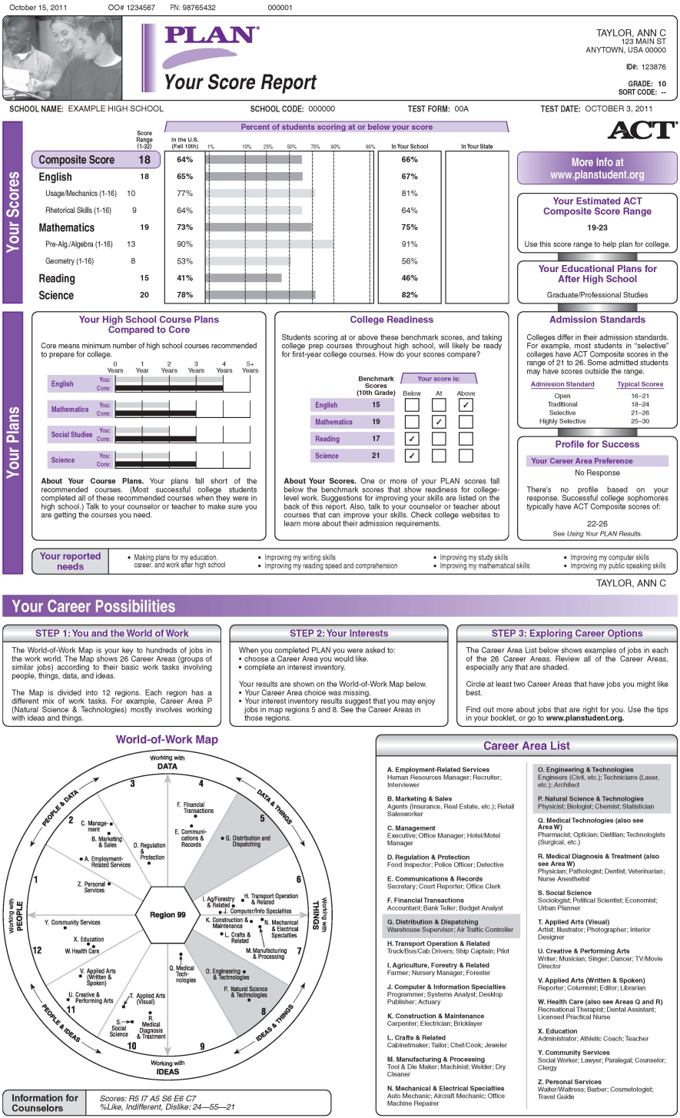
PLAN Score Report Side 1
Notes:
RC

Slide 6
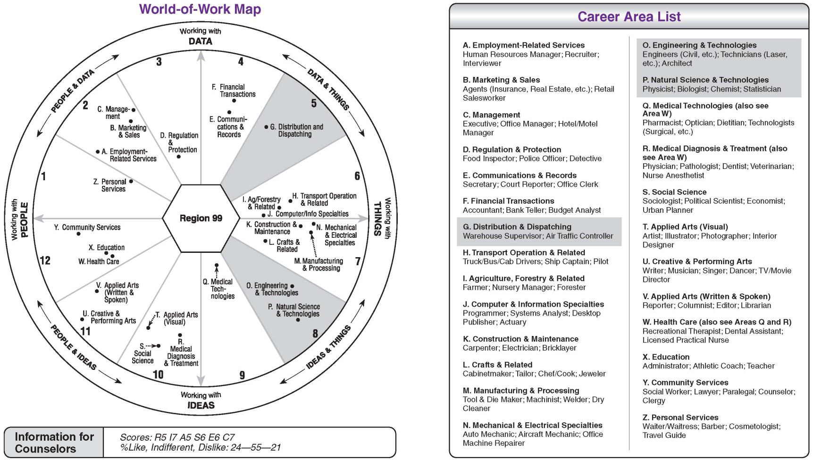
Your Career Possibilities
Notes:
RC

Slide 7
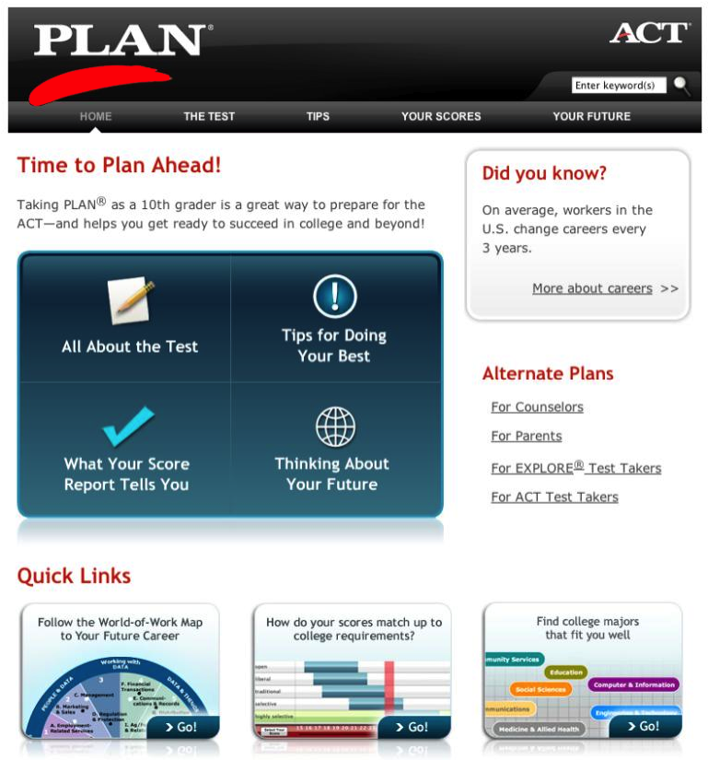
www.planstudent.org
Notes:
RC
Career/Interest Information
-Interactive World of Work Map is available online at www.planstudent.org,
-Map of College Majors
-www.f4k.org
-p. 9 of the Using the PLAN results booklet – additional websites including the military

Slide 8
Military Options
www.f4k.org – Futures for Kids has information on military careers
Military Recruiters for general enlistment – email counselor for recruitment contacts, tonight’s handout
March2Success – www.march2success.com
ASVAB Testing
Military Academies – rigorous application process – starts earlier than most college application processes
*information sessions to attend with lawmakers, targeted for 7th-12th graders with interest
*summer programs – ex. Naval Academy has a Summer STEM program for 8-11th graders, they also have Summer Seminar for rising seniors, summer athletic camps
Notes:
RC

Slide 9
College Research and Planning
College Planning File
College Email Account
College admission representatives visit HHS – during Husky Help
College Fairs – in person and virtual
NACAC Spring Fair - Tues, March 11 4-8pm
www.collegeweeklive.com –December 12 All Access
Basic college discussions and research

Slide 10
Resources for College Research
www.cfnc.org – student account create now!
www.collegeboard.org
www.ycg.org
www.f4k.org
School Counselor
Career Development Coordinator
Tonight’s handout
Keep an open mind
Notes:
Pull up these websites

Slide 11
PSAT/PLAN Testing
PLAN is Thursday, October 3th at 7:25 a.m.
PSAT is Wednesday, October 16^{h} at 7:25am—Students can still register through Friday!!!
“Practice” SAT and ACT
Student Search Service – opt in
College Planning Resource – MyCollegeQuickstart
NMQST in their Junior Year
Scores back in December or January – look for score report and MyCollege Quickstart code
Notes:
Who takes the PSAT? All Sophomores who have taken Algebra I, Juniors and Freshmen who registered.
Who takes the PLAN? All Sophomores

Slide 12
SAT and ACT
Juniors- Will be taking the ACT on March 5
When to take SAT and ACT
SAT Subject Tests
Student Search Service- Opt-in
Sending your scores
Fee Waiver
Notes:
Melanie: Junior Slide, concordance table-add link to slide

Slide 13
Academics
Where do you stand academically?
What is your current GPA?
How many credits have you earned?
Graduation Requirements – 26 credits and certain classes
Promotion Requirements –
11th: English 2, math credit, science credit, social studies credit, 12 credits overall
12th: English 3 and program leading to completion of requirements, 18 credits overall

Slide 14
Academics continued…
Check PowerSchool regularly for Academic Progress and keep your grades up
Ask for help – Teachers, Counselors, Husky Help, etc.
Academic Help Handout
Important Upcoming Dates: October 25: End of 1st Quarter. November 4th – report cards to students, November 13th – Conference night
Does my current performance match my post-secondary goals?

Slide 15
UNC System Minimum Admissions Requirements
 | Minimum HS GPA | Minimum SAT (CR+M) | Minimum ACT (Composite Score)
Fall 2013 and Beyond | 2.5 weighted | 800 | 17
The UNC System includes 17 colleges and universities in NC. Click here for the complete listing.

Slide 16
Academic Planning
4 year plan, transcript check, graduation checklist
Registration for next year – late winter/early spring
Purposeful Planning – rigor and interest
Important Date – February 27 – Curriculum Fair
Junior Conferences in the Spring
Additional Options to consider – dual enrollment courses (NCVPS, etc), early graduation – if these are a good fit for your post secondary goals

Slide 17
AP Courses
Importance of AP Courses
Curriculum Fair-AP Session
Registration and Summer Expectations for AP Courses
Summer Drop Date
Notes:
Drop Add, Add link to AP summer assignments

Slide 18
Get involved!
Extracurricular Activities
*School Extracurricular Activities – here is a link to our 2013 – 2014 club list: http://www.heritagehs.wcpss.net/#!student-life/c11m6
*Outside of School – community service, employment, outside organizations
*Leadership: Quality v. Quantity
Extra Opportunities
*School year – NCSSM-10th grade
*Summer programs – Governor’s School, HOBY-10th, Summer Ventures in Science and Math, check this link for more: http://heritagehs-student-services.weebly.com/summer-opportunities.html
Notes:
Mentioning matching activities to goals- i.e. science clubs/activities for Gov School and NCSSM, Engineering prgms, etc.

Slide 19
College Athletics
NCAA Eligibility – Division I and II
Core GPA – different than overall GPA, only core classes count
SAT and ACT score requirements
www.ncaaeligibilitycenter.org
http://www.ncaapublications.com/productdownloads/CBSA.pdf - Guide for the College Bound Student Athlete
TBD -College Athletics Events – Fall and Spring
2.3
Handout for anyone interested

Slide 20
10th Grade Timeline and Advice
Pulse check – where are you GPA wise?
Compare your current status with your future goals
Focus on your grades
PLAN and PSAT – take these exams, learn about your scores
Get involved – clubs, sports, community service, find your passion
Summer programs
Take spring registration seriously – use your time and resources

Slide 21
Junior Year Timeline
GPA—Very important year
Testing— Take seriously
Begin serious college and career research

Slide 22
Questions?
Please complete survey either paper version or online: http://tinyurl.com/kmhwcgy

Slide 23
Student Services
Ms. Deirdra Williams, Dean of Students, dcwilliams@wcpss.net
Ms. Yvonne Corcho, Students A-D ycorcho@wcpss.net
Ms. Erin Macleod, Students E-K, emacleod@wcpss.net
Ms. Melanie Lachance, Students L-Rh, mlachance@wcpss.net
Ms. Rachael Confer, Students Ri-Z, rconfer@wcpss.net
Ms. Barbara Wiggins, Career Development Coordinator, bswiggins@wcpss.net
Ms. Melanie Spainhour, SAP Counselor, mspainhour@wcpss.net
Thank you for coming out tonight!
Thank you, too, for filling out and leaving our evaluation form.

